Slide 1
The effects of Covid in Iceland

Slide 2
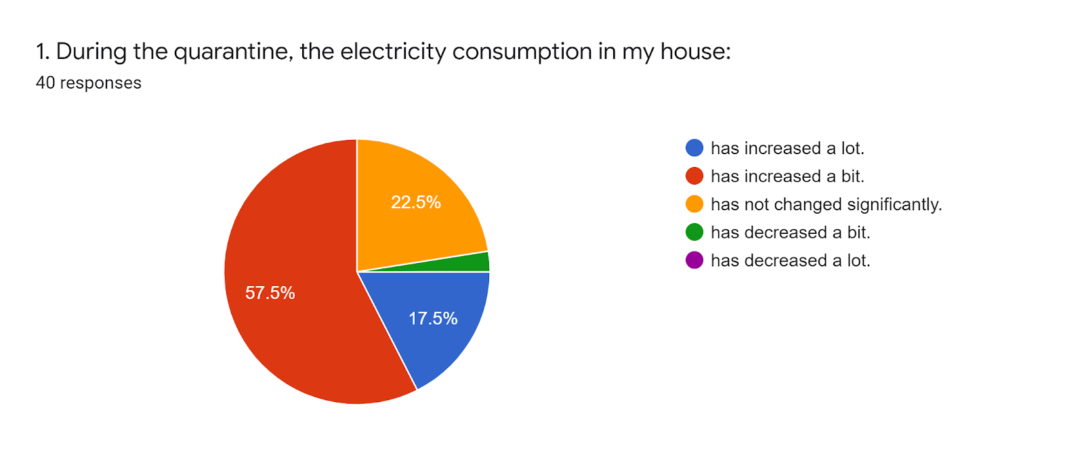
Most students said electricity consumption had increased a bit.
Notes:
During quarantine 57,5% of the participants in this survey said the electricity consumption had increased a bit.
17,5% said it had increased a lot.
Because of COVID and quarantine many people had to stay at home and that may have caused higher electricity usage.

Slide 3
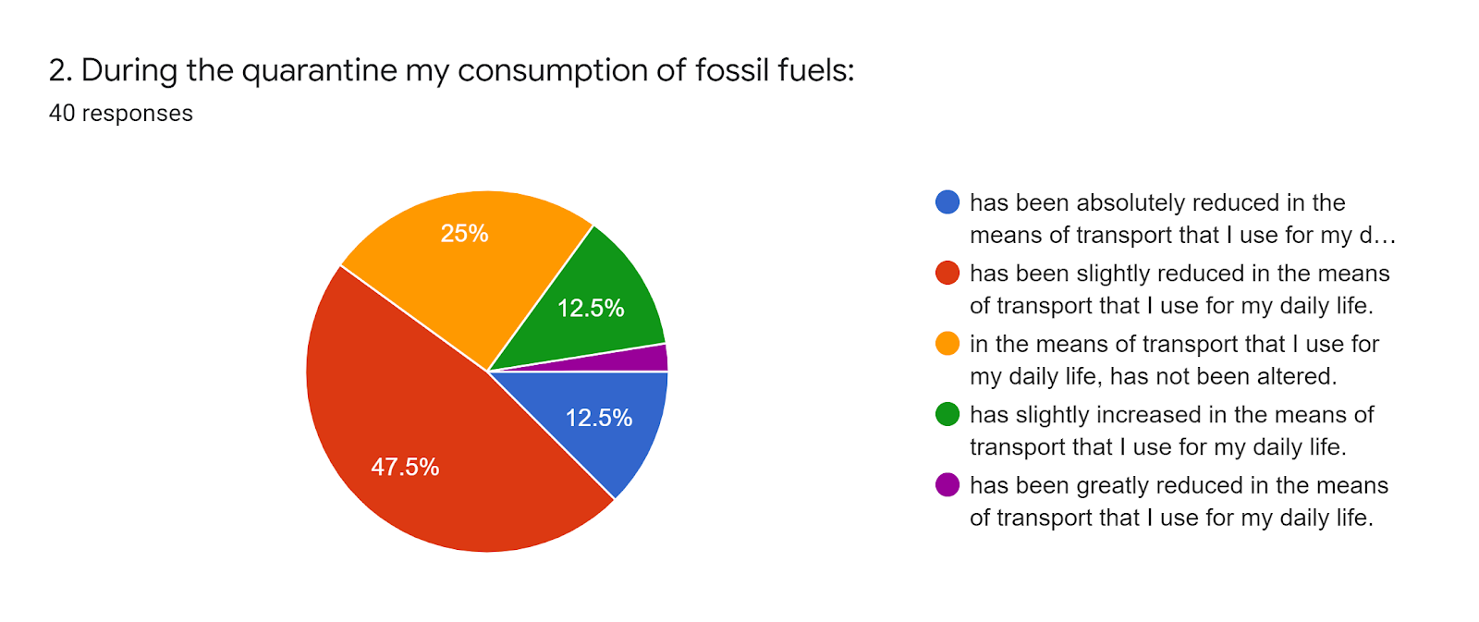
Most students said consumption of fossil fuels had been slightly reduced.
Notes:
47,5% say the consumption of fossil fuels has reduced slightly in their daily life.
We in Iceland have not had to quarantine or been in lockdown a lot like other countries have, so there haven’t been lot of changes.

Slide 4
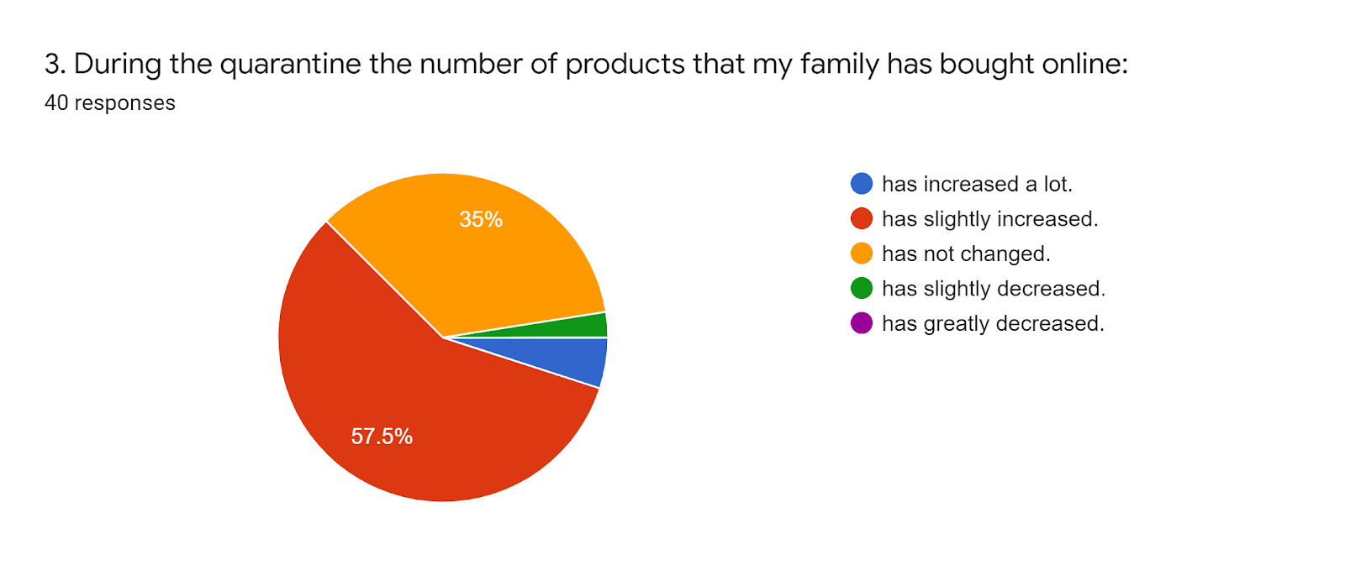
Most students said online shopping had increased slightly.
Notes:
57,5% say that they’re online shopping has slightly increased, and we think it might be because of fast fashion and new trends that keep coming.
A large amount of people have also started grocery shopping online so they’re not taking any risks.

Slide 5
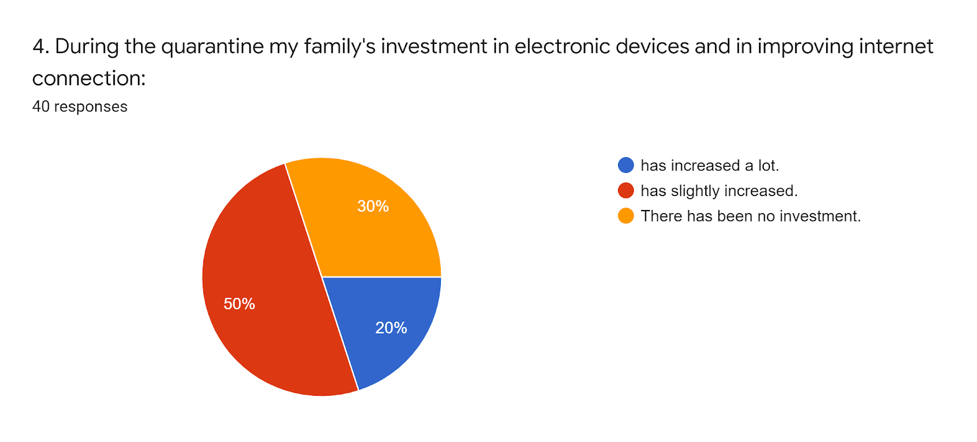
Half of the students said family’s investment in electronic devices had increased a bit.
Notes:
During the pandemic a lot of people had to start communicating through the internet and may have had to update they’re electronics and internet connections.
50% in this survey say that their family’s investments in electronic devices and internet connections have increased slightly.

Slide 6
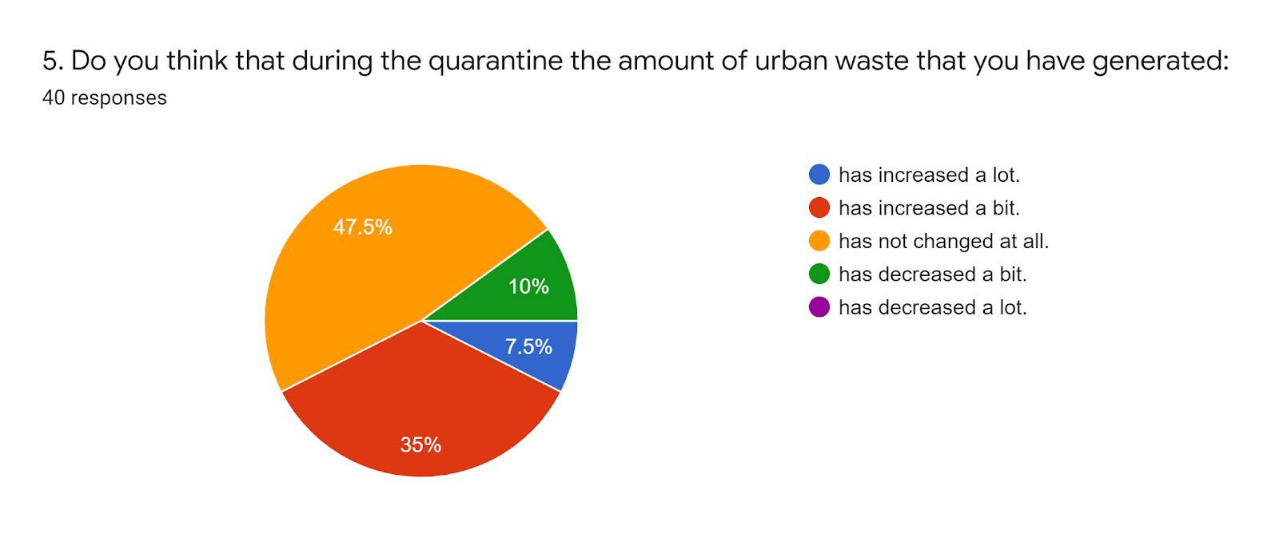
Most of the students said that urban waste generated had not changed during the epidemic.
Notes:
Most students say the urban waste has not changed at all which makes sense cause we were not in quarantine a lot.

Slide 7
Conclusions
Most students did not see big changes in energy consumption, online shopping or waste generated during the quarantine.
17.5% of the students said electricity consumption had increased a lot. The same proportion of students, 12.5%, said fossil fuel consumption had increased a lot and decreased a lot.
In Iceland the elementary schools were only closed for a short period (~4 weeks), same with many workplaces although more people worked from home. This is likely to affect the results.

