Slide 1
The impact of the climate change on the environment

Slide 4
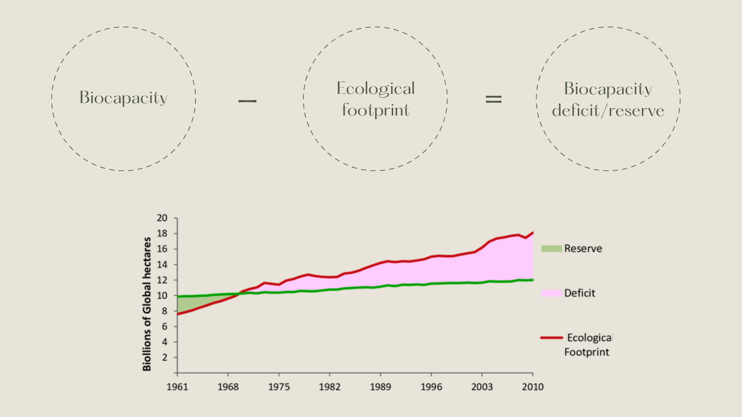

Slide 6
What are the most produce country?
The most producing country is China.

