Slide 1

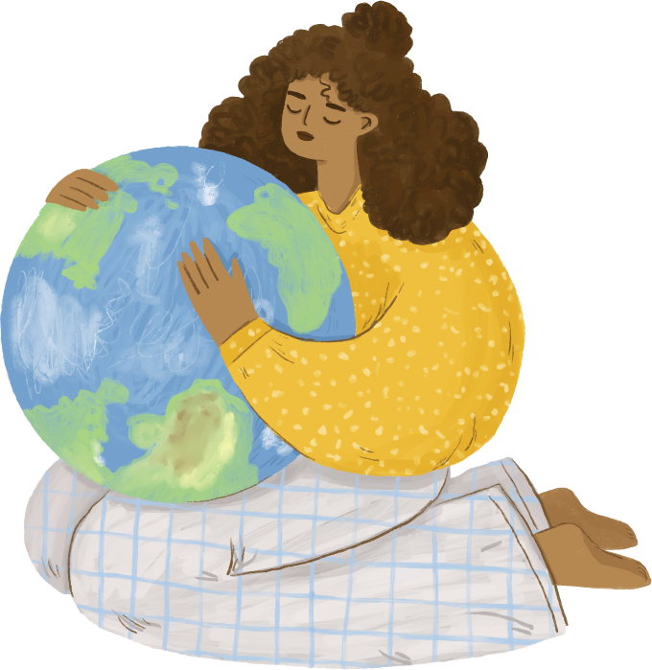
The greenhouse effect and how it affects the environment
Karanikas Dimitris
Syrros Lampros Evaggelos
Malandrinos Foths
Kantolas Marios

Slide 2

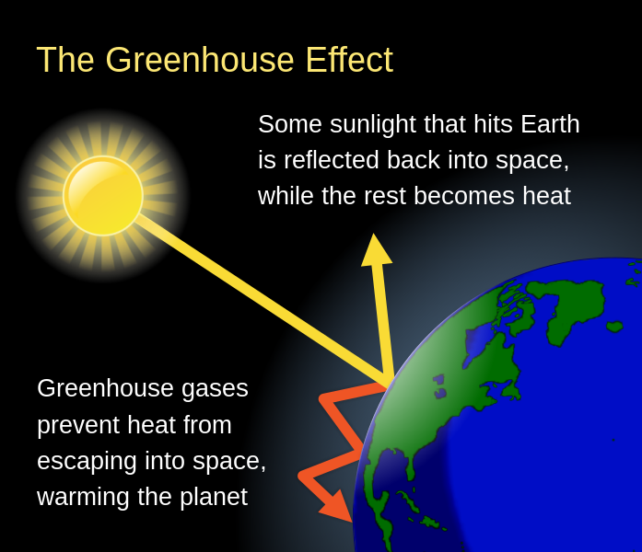
Natural Greenhouse event and its protecting function
Definition: The greenhouse effect is a process that occurs when gases in Earth’s atmosphere trap the Sun’s heat. This process makes Earth much warmer than it would be without an atmosphere.

Slide 3



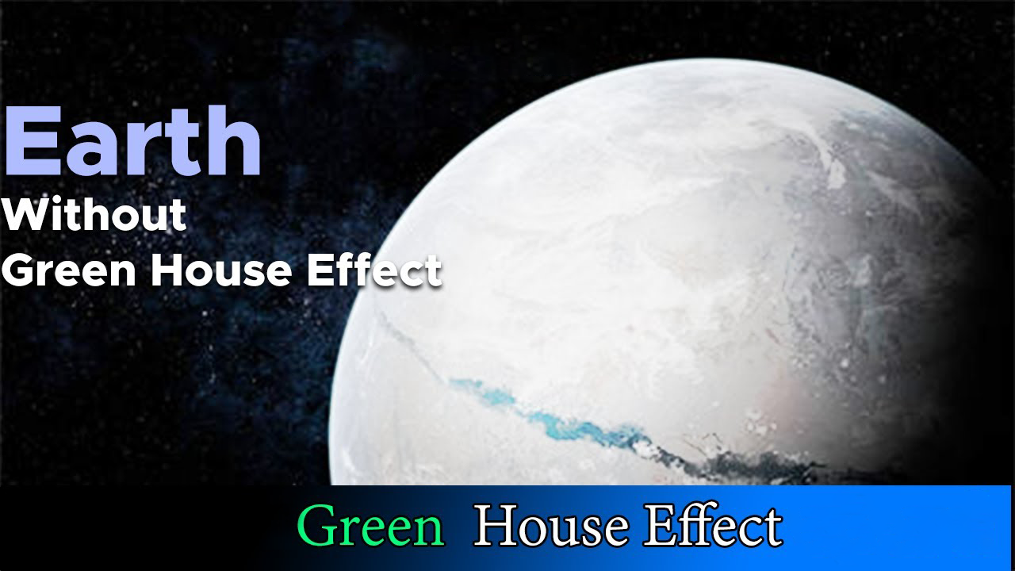

Natural Greenhouse event and its protecting function
Why is it important for life in the planet?
Greenhouse gases which trap the Sun’s heat are crucial to keeping our planet at a suitable temperature for life. Without them the heat emitted by the Earth would simply pass outwards from the Earth’s surface into space
-20 °C Temp
Results:
Without any greenhouse gases, Earth would be an icy wasteland making the planet uninhabitable by humans

Slide 4

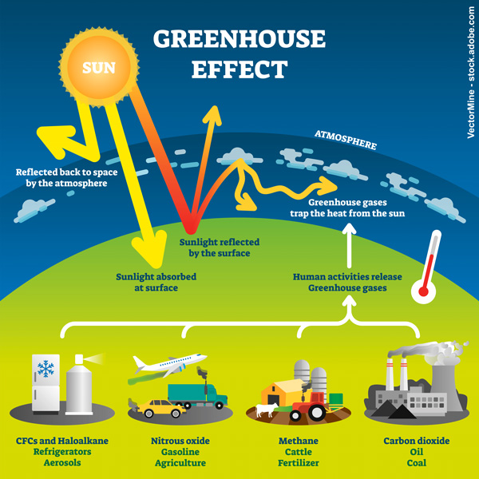
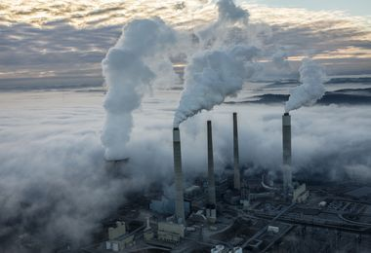
Overview of Greenhouse gases
The main greenhouse gases are :
1. Carbon dioxide (CO2)
2. Methane (CH4)
3. Nitrous oxide (N2O)
4. Chlorofluorocarbon-12 (CFC-12)
5. Fluorinated gases which are synthetic
Major sources of the greenhouse gases
Carbon Dioxide: Fossil fuel combustion , Deforestation Cement production and certain chemical reactions
Methane: Fossil fuel production, transport of coal, natural gas and oil, agriculture, landfills
Nitrous Oxide: Fertilizer application , fossil fuel and biomass combustion , industrial processes
Chlorofluorocarbon-12 (CFC-12): Refrigerants

Slide 5

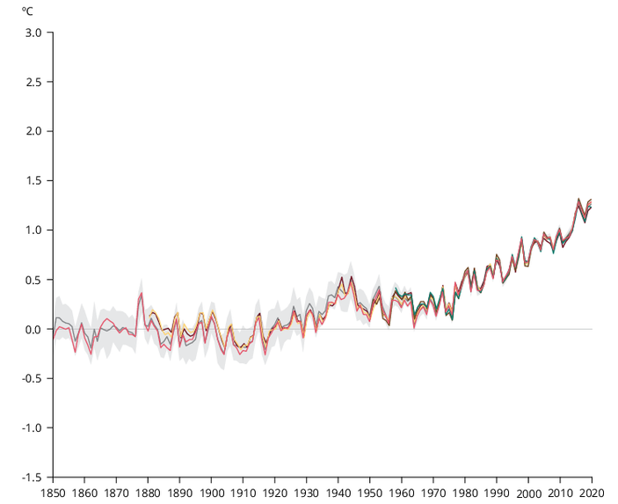
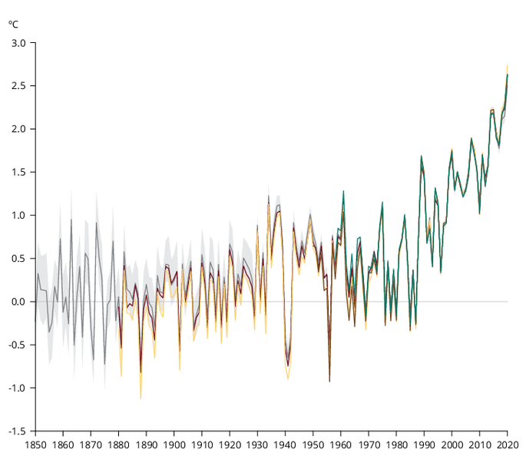

Average temperature data
Global Data
European Data
Europe has warmed more than the global average

Slide 6
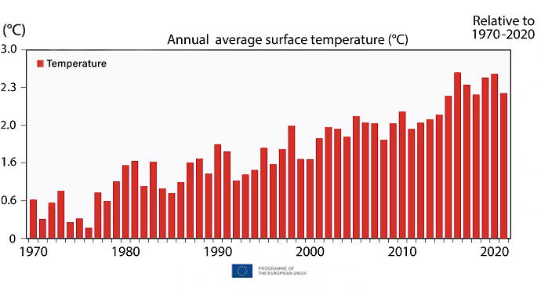
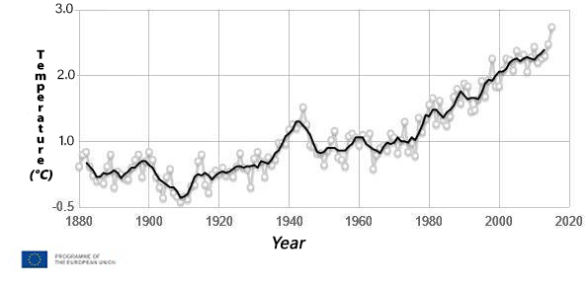
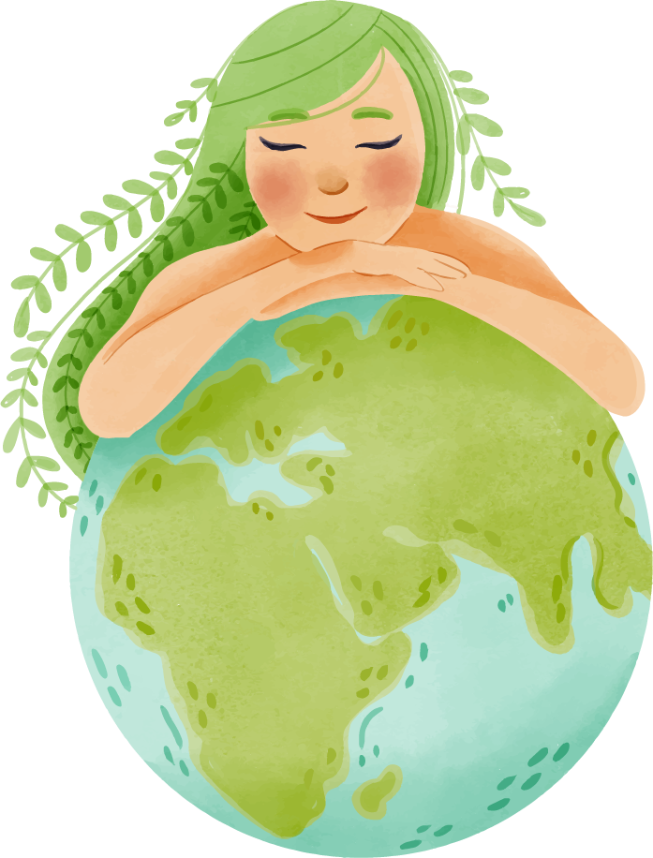
More Graphs about Temperatures…
Max Temp: Approximately 3 °C

Slide 7



Negative impacts of global warming on the weather
A warmer climate makes atmosphere to collect and drop more water:
WET
WETTER
DRY
DRIER
This way storms, disasters, heat waves, floods and droughts are created

Slide 8

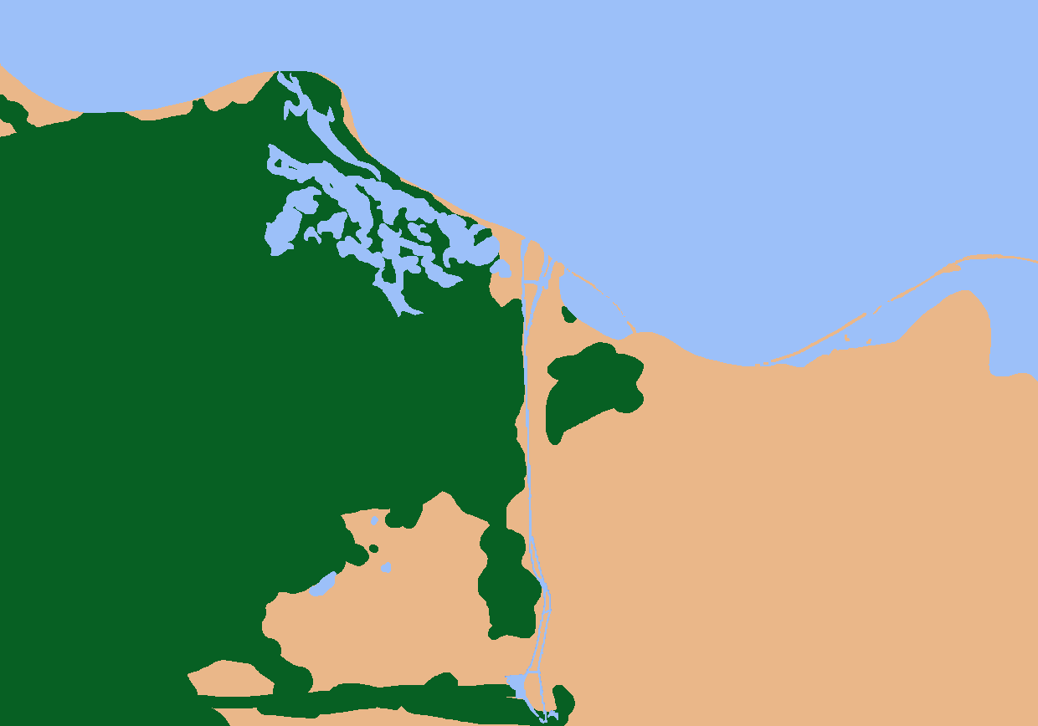



Lessepsian Migration
How does global warming affect sea creatures
Definition: The Lessepsian migration (Erythrean invasion) is the migration of marine species across the Suez Canal, usually from the Red Sea to the Mediterranean Sea. Their name is from the French engineer F.Lesseps who designed the Suez Canal
Mediterranean Sea
The effect of global warming
As the temperature of Mediterranean rises, Lessepsian Immigrants start moving at an increase rate from the Red Sea to Mediterranean Sea
Suez Canal

Slide 9
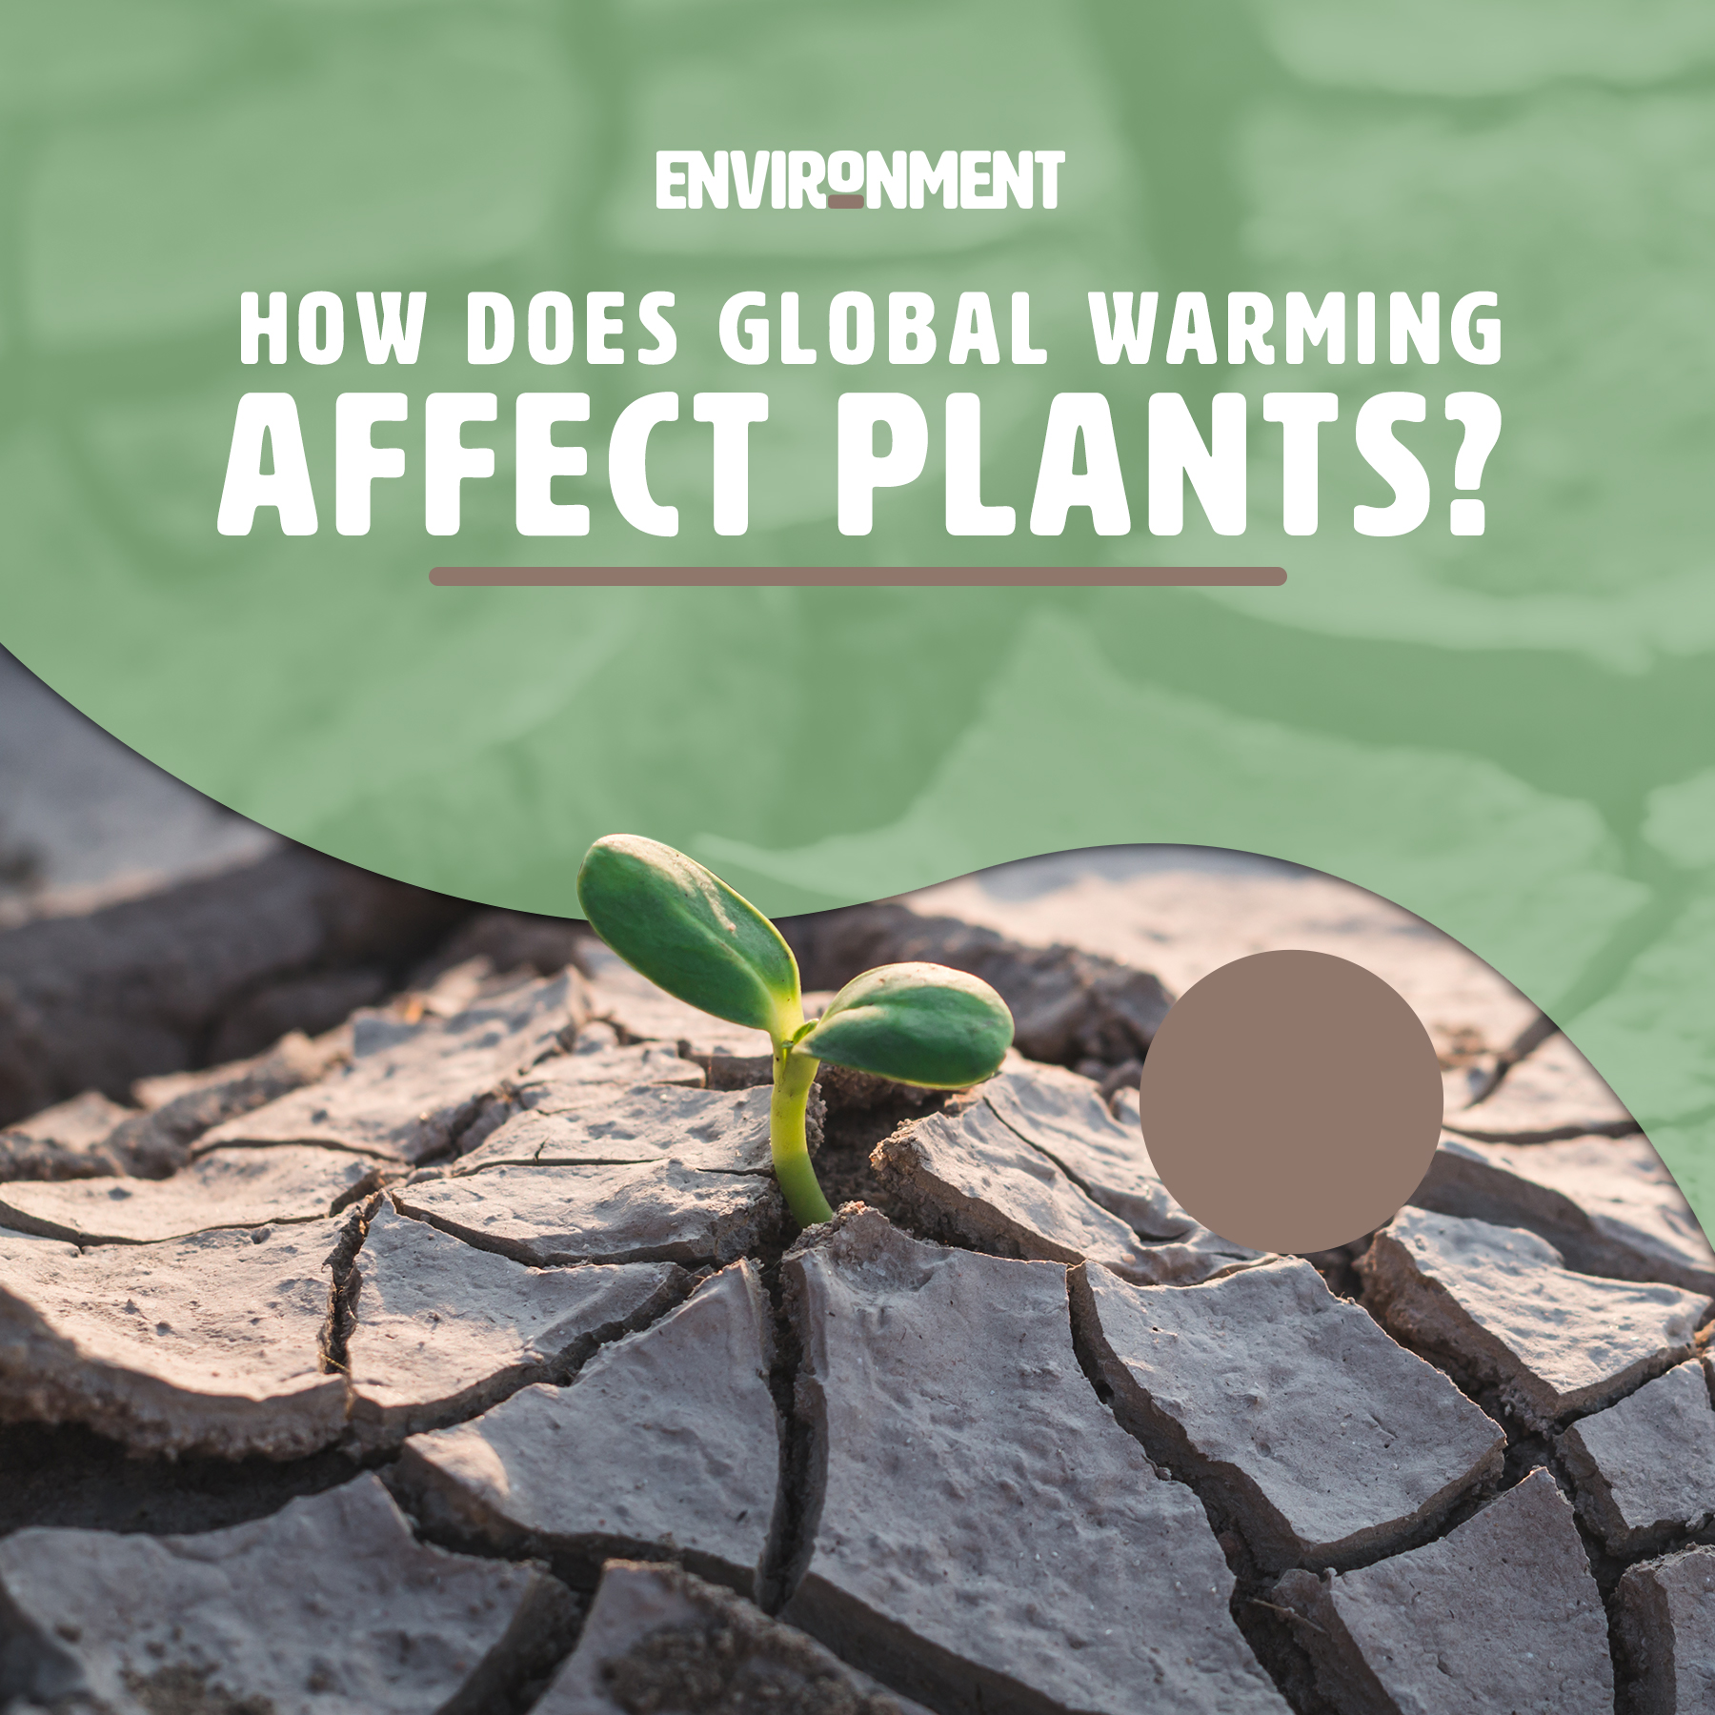
How does global warming affect plants
Researchers say that although carbon dioxide and warmer temperatures generally improve photosynthesis, the pores on plant leaves become smaller evapotranspiration
Rising temperatures make land dry, leading to loss of plants. Plants are becoming less productive.
Plants are starting to grow and bloom earlier in the spring and survive longer into the fall

Slide 10
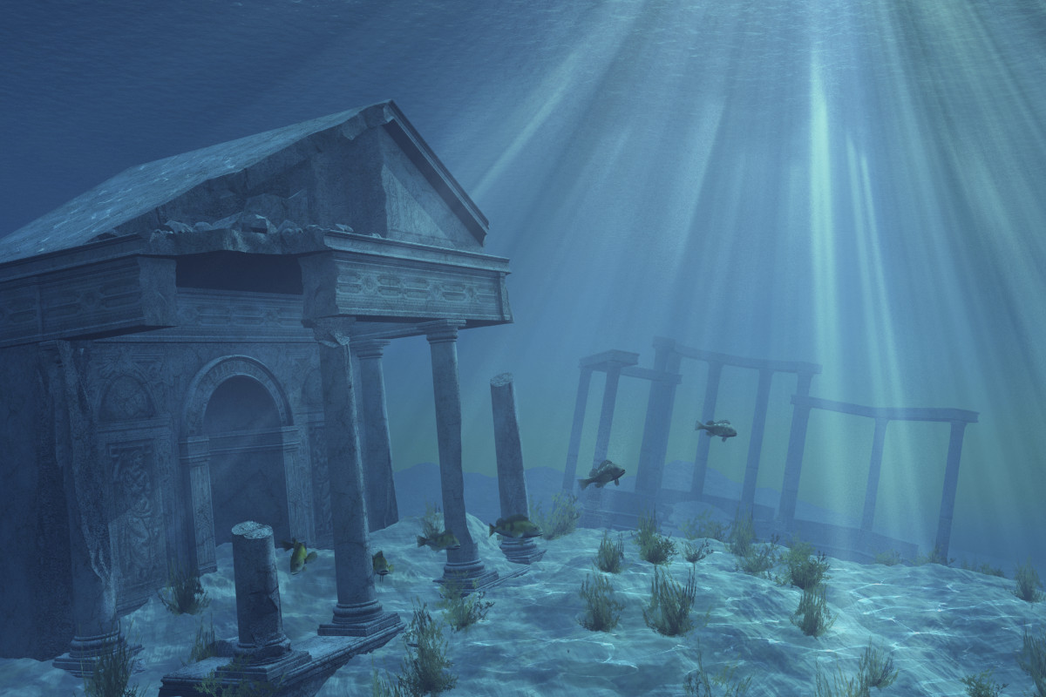
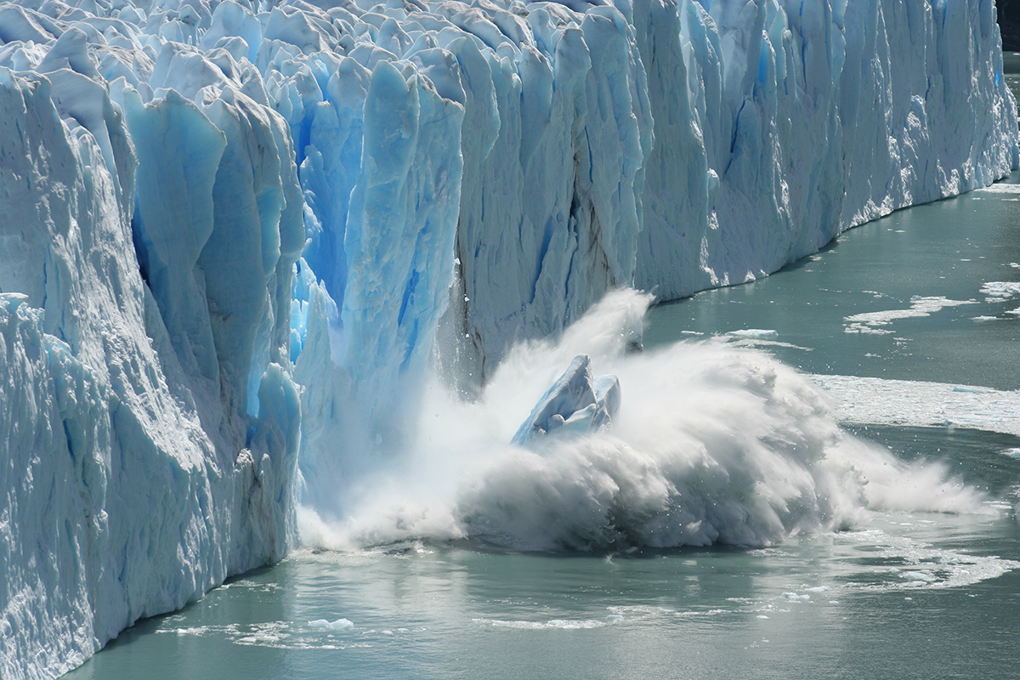
Melting poles and Sea Level
Global warming makes earth warmer and warmer over time. This is why glaciers and ice on the two opposite poles are melting. This makes the sea level rising worldwide.
As a result, there is coastal flooding where land near sea is becoming extinct due to rising sea level. However, global warming is not the only factor that helps this problem

Slide 11
Sources
Worldwildlife.org
Sciencing.com
Lisbdnet.com
Wiki.com
Europa.eu/Eurostat
News.un.org
Nationalgeographic.com
Climatekids.nasa.gov

Slide 12
END OF PRESENTATION

